Slide 1
Assumptions of Physics Summer School 2025 Some results in Physical Mathematics
Gabriele Carcassi and Christine A. Aidala
Physics Department University of Michigan

Slide 2
Overview

Slide 3
Space of the well-posed scientific theories
Physical theories
Unitary evolution
Specializations of the general theory under the different assumptions
Hamiltonian mechanics
Quantum state-space
Classical phase-space
Infinitesimal reducibility
Determinism/
reversibility
Irreducibility
Assumptions
States and processes
General theory
Information granularity
Basic requirements and definitions valid in all theories
Experimental verifiability

Slide 4
Theoretical statements
Quantities from references
Experimental verifiability
$$⇓$$
Topology and $σ$-algebra
Verifiable statements
Possibilities
before
after
Refinable aligned strict references
$$⇓$$
Real numbers
Points
References act as Dedekind cuts
Open sets
Borel sets
Statistical mixtures $⇒$ Convex (linear) structures
$P_{1}$
$$e_{1}$$
$$S_{p}$$
$$pe_{1}+\left(1−p\right)e_{2}$$
$P_{2}$
$$e_{2}$$
Variability/entropy $⇒$ Geometric structures

Slide 5
Recover the reals

Slide 6
In physics, we use real numbers to model physical quantities
$$ℝ$$
Needed for a lot of mathematical tools: exponential, gaussians, trigonometry, …
Yet, we know that infinite precision is an idealization
Many ways to mathematically construct the real numbers
As a field, as Cauchy sequence of rationals, as Dedekind cuts of rationals…
How can we define them in physical mathematics?
What do real numbers model?

Slide 7
Order topology
Given $\left(𝒬,≤\right)$, the order topology is the one generated by the test $\{q>a\}$ and $\{q<b\}$ for all $a,b∈𝒬$
This means that “the object is after $a$” and “the object is before $b$” are verifiable statements
Note: topology only knows about order, not about the size of the intervals!!!

Slide 8
Reals can be characterized as a type of linear order
Cantor’s isomorphism theorem
1) Every countable dense linearly ordered set with no ends is order isomorphic to the rationals
One element is always before or after another
Always an element between two
No greatest or smallest
Bijection with naturals
2) The completion of a linear order is unique
Every subset has a supremum and an infimum
$⇒$ Every complete linearly ordered set with no ends that has a dense countable subset is order isomorphic to the reals
Since the reals are the completion of the rationals

Slide 9
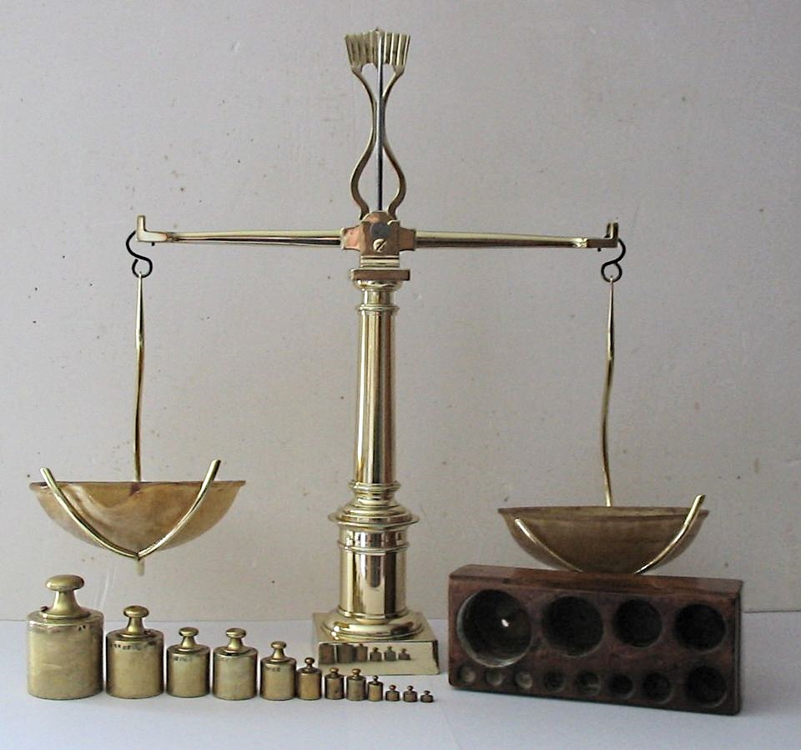
How is order defined experimentally?
wikipedia
We have a way to compare two things, and decide whether one is bigger/smaller than the other. “Exactly the same” is a bit more difficult.
A reference (e.g. a tick of a clock, notch on a ruler, sample weight with a scale) is something that allows us to distinguish between a before and an after
before
after
on
“Before/after a reference” are verifiable statements

Slide 10
Goal: make a mathematical model of a reference system
before
after
on
Before | On | After
T | F | F
F | T | F
F | F | T
T | T | F
F | T | T
T | T | T
A reference system is a collection of references. The experimental domain for a quantity is the set of verifiable statements generated by all possible before/after statements.

Slide 11
1. Strict references
A reference is strict if before/on/after are mutually exclusive
before
after
Before | On | After
T | F | F
F | T | F
F | F | T
on
Physically, the extent of what we measure is assumed to be smaller than the extent of our reference

Slide 12
Multiple references
Without further constraints, references would not lead to a linear order
before
after
on
on
 | $$b_{2}$$ | $$o_{2}$$ | $$a_{2}$$
$$b_{1}$$ | ✔ | ✔ | ✔
$$o_{1}$$ | ✔ | ✔ | ✔
$$a_{1}$$ | ✔ | ✔ | ✔
before
after

Slide 13
2. Aligned references
$$b_{2}$$
$$a_{2}$$
$$o_{2}$$
Two references are aligned if the before and not-after statement can be ordered by narrowness/implication
$$o_{1}$$
$$b_{1}$$
$$b_{2}$$
$$¬a_{1}$$
$$¬a_{2}$$
For example, $b_{1}≼b_{2}≼¬a_{1}≼{¬a}_{2}$
$≼$ Means that if the first statement is true then the second statement will be true as well
That is, the first statement is narrower, more specific
$$b_{1}$$
$$a_{1}$$
Basic insight: the ordering of the points corresponds to the order of statements by narrowness

Slide 14
Filling the whole region
$$b_{2}$$
$$o_{2}$$
$$a_{2}$$
$$o_{1}$$
If two different references overlap, we can’t say one is before the other: we can’t fully resolve the linear order
$$a_{2}$$
$$b_{1}$$
$$a_{1}$$
$$o_{1}$$
$$b_{2}$$
$$o_{2}$$
Moreover, if two references don’t overlap and there can be something in between, we must be able to put a reference there
$$b_{1}$$
$$a_{1}$$

Slide 15
3. Refinable references
$$o_{3}$$
A set of references is refinable if we can address the previous two problems and resolve the full space
$$b_{2}$$
$$a_{2}$$
$$o_{2}$$
$$o_{1}$$
If two references overlap, we can find a reference that refines the overlap
$$b_{1}$$
$$a_{1}$$
$$o_{3}$$
$$o_{1}$$
$$b_{2}$$
$$o_{2}$$
$$a_{2}$$
If something can be found between two references, then there must be another reference in between
$$b_{1}$$
$$a_{1}$$

Slide 17
Reference ordering theorem
To define an ordered sequence (e.g. of “instants”), the references must be (nec/suff conditions):
Strict – an event is strictly before/on/after the reference (doesn’t extend over the “on”)
Aligned – shared notion of before and after (logical relationship between statements)
Refinable – overlaps can always be resolved
Gives you ordered points with the order topology
Additionally:
Dense order, which the closure on arbitrary union completes
Between any two references we can always have another reference $⇒$ real numbers
Only finitely many references between any two references $⇒$ integers
For time/space, these conditions are idealizations

Slide 18
How does this model break down?
The ticks of a clock have an extent and so do the events (references not strict)
If clocks have jitter, they cannot achieve perfect synchronization (references not aligned)
We cannot make clock ticks as narrow as we want (references not refinable)
No consistent ordering: no “consistent” “before” and “after”
In relativity, different observers measure time differently, but the order is the same. We should expect this to fail at “small” scales.
A better understanding of space-time means creating a more realistic formal model that accounts for those failures

Slide 19
What type of models should we use?
Hard to say, but we can argue from necessity
(N.B. this is a toy model, each point should have infinitely many neighbors)
Lack of order at small scales, order at large enough scale
What we can distinguish experimentally (i.e. topology) seems to be linked to how precisely we want to distinguish (i.e. geometry)
Current mathematical tools have a hard division between topology and geometry
Need new math?

Slide 20
Takeaways
Real numbers can be recovered from an idealized metrological model
Ordering of values comes from the ordering logical structure
$3≤5$ precisely because “there are less than 3 items” $≼$ “there are less than 5 items”
The hard part is the ordering, not the “continuity”
The difference between reals and integers is, as one intuitively expects, the ability to always find something in between two references
Completeness of the ordering is implied by the topology
Failure of the idealization under real numbers would lead to a structure much richer (and more complicated) than a linear order

Slide 21
Ensemble spaces (generalized state spaces)

Slide 22
$⇒$ Scientific laws are relationships between ensembles
Preparation procedure
A physical theory must AT LEAST describe which ensembles are possible within the theory
Initial ensemble
Physical process
Final ensemble
Measurement procedure
Statistical data

Slide 23
State space
Ensembles
Classical discrete
$$X=\{x_{1},x_{2},…\}$$
$ℰ=\{ p_{i} | \sum_{i}{p_{i}}=1\}$
Phase space Symplectic manifold
$ℰ=\{ ρ∈L^{1}\left(ℝ^{2n}\right) |$ $∫ρdq^{n}dp_{n}=1\}$
Classical continuum
$$X=\{ℝ^{2n},ω\}$$
Projective complex Hilbert space
$ℰ=\{$ positive semi-definite Hermitian with $tr\left(ρ\right)=1 \}$
Quantum mechanics
$$X=P(ℋ)$$

Slide 24
Experimental verifiability $⇒$ topological space
Topology is responsible for handling limits and infinite operations
All other axioms are on finite elements

Slide 25
Statistical mixtures $⇒$ Convex structure
$$pa+\overline{p}b$$
$$a$$
$$b$$
Only finite mixtures $\sum_{i=1}^{n}{p_{i}e_{i}}$are guaranteed
$P_{1}$
$$e_{1}$$
Topology tells us which infinite mixtures $\sum_{i=1}^{∞}{p_{i}e_{i}}$ converge
$$S_{p}$$
$$pe_{1}+\left(1−p\right)e_{2}$$
$P_{2}$
$$e_{2}$$
I.e. where experimental verifiability converges
NB: the theory of topological vector spaces is well developed, but not the theory of topological convex spaces

Slide 26
b
a
Ensembles represent a collection of preparations which are, in general, not identical
Variability: how similar are the preparations within an ensemble?
Entropy is a measure of variability

Slide 27
a
$$S\left(pa+\overline{p}b\right)$$
p
Variability after mixture
Average variability before mixture
b
$$pS\left(a\right)+\overline{p}S\left(b\right)$$
Final variability will be greater than average variability before mixture
If we mix an ensemble with itself, the variability is unchanged

Slide 28
a
$$S\left(pa+\overline{p}b\right)$$
p
Variability after mixture
Average variability before mixture
b
$$pS\left(a\right)+\overline{p}S\left(b\right)$$
Maximum increase when the ensembles are “completely different”
Increase is only a function of the mixing coefficient

Slide 29
a
c
b
If a has no elements in common with b or c,
it has no elements in common with any mixture

Slide 30
Ensemble variability $⇒$Entropy
No standard theory of entropic spaces

Slide 31
These axioms specify very minimal necessary requirements on physical theories
How much can we derive just from these?
Physical mathematics starts with minimal requirements to force us to understand which requirements are truly independent and truly necessary
Here are a few things we are able to derive…

Slide 32
The entropy upper bound $I(p,\overline{p})$ is uniquely determined
Shannon entropy
Maximal increase in variability during mixing
Let’s see how it works

Slide 33
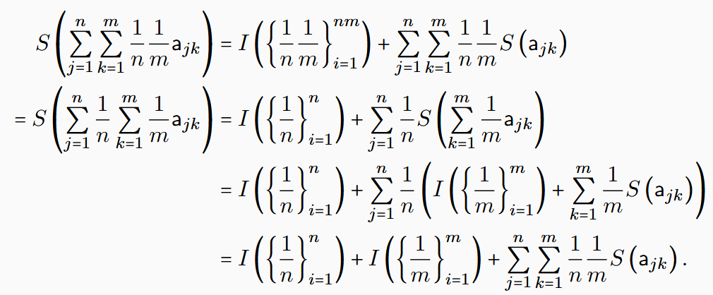
Pick $a_{i}$ all orthogonal to each other
Uniform mixture of $n×m$ elements
$S\left(\sum_{i}{p_{i}a_{i}}\right)=I\left(p_{i}\right)+\sum_{i}{p_{i}S\left(a_{i}\right)}$
Must be the same
Uniform mixture over $n$
uniform mixtures of $m$ elements

Slide 34
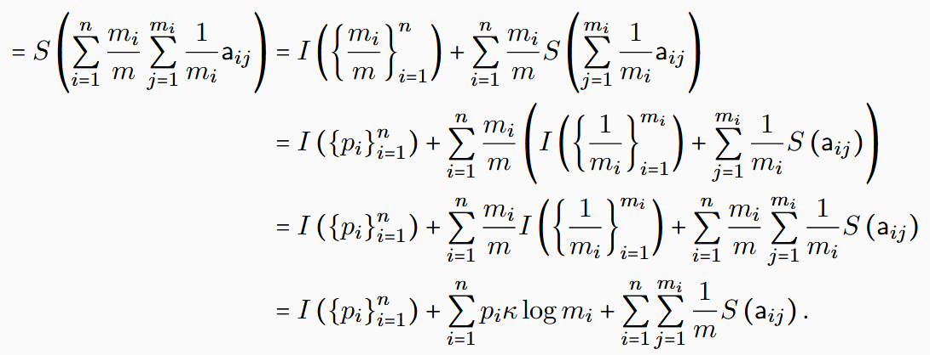
Pick $a_{i}$ all orthogonal to each other
Uniform mixture of $m$ elements
$S\left(\sum_{i}{p_{i}a_{i}}\right)=I\left(p_{i}\right)+\sum_{i}{p_{i}S\left(a_{i}\right)}$
$$\frac{1}{15}$$
Must be the same
$$\frac{2}{15}$$
$$\frac{4}{15}$$
$$\frac{3}{15}$$
$$\frac{6}{15}$$
Rational distribution over
uniform mixtures of grouped elements

Slide 35
From now on, $\log{p}$ is base 2
$I\left(p,\overline{p}\right)=−p\log{p}$ $−\overline{p}\log{\overline{p}}$
Proof “does not know” whether we are dealing with classical ensembles, quantum ensembles, or ensembles for a theory yet to be discovered
Proof is short (about two pages)

Slide 36
Two ways to define “exclusive” ensembles
Separate ensembles
Orthogonal ensembles
$$⇐$$
No “common component”
Saturate upper entropy bound
such that
Coincide in classical ensemble spaces
Different in quantum ensemble spaces
Simple but powerful definitions from basic axioms
$${|ψ}_{a}⟩$$
$${|ψ}_{c}⟩$$
disjoint support
$${|ψ}_{b}⟩$$

Slide 37
Vector space constraints from entropy

Slide 38
Entropy bounds force mixing to be “invertible”
$$a$$
$$b$$
$$ra+\overline{r}b$$
Can define affine combinations (i.e. negative probabilities)

Slide 39
Ensemble spaces embed into vector spaces
Vector space operations derived from mixing operations
$$b$$
$$1(b−a)$$
$$\frac{1}{2}c+\frac{1}{2}b=a$$
$$a$$
$$⇕$$
$$1(c−a)$$
$$1\left(c−a\right)=−1\left(b−a\right)$$
$$c$$

Slide 40
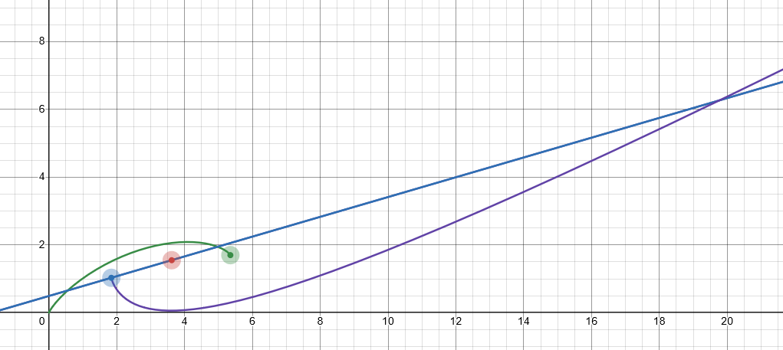
$$V$$
$$ℰ$$
Ensemble spaces are bounded in all directions
Entropy bounds $⇒$ green point between blue and purple curves
Entropy
Fix three points (i.e. origin, blue and red points)
Ensembles over a line

Slide 41
Geometric structures from entropy

Slide 42
How much does the entropy increase during mixture?
Recovers the Jensen-Shannon divergence (JSD) (both classical and quantum)
Pseudo-distance defined from the entropy
(does not satisfy the triangle inequality)

Slide 43
Entropy imposes a metric on the ensemble space
$$⇒$$
Entropy strict concavity means the Hessian is negative definite
Recovers Fisher-Rao information metric (both classical and quantum)

Slide 44
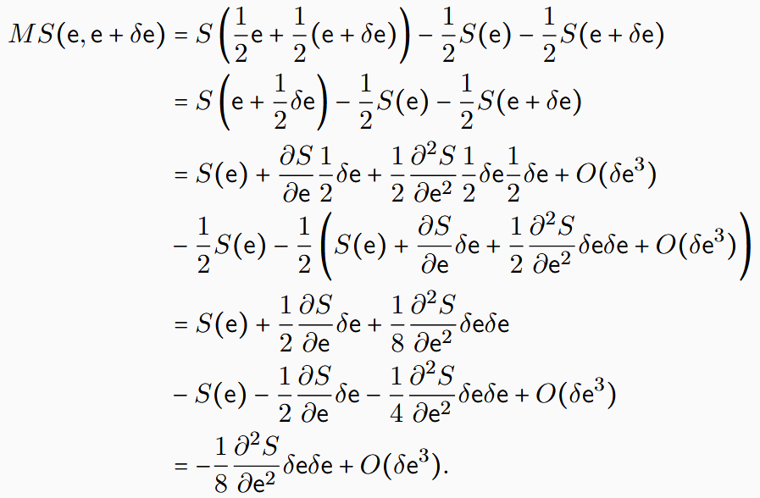
Another direct calculation from the definitions

Slide 45
Measure theoretic structures from entropy

Slide 46
In classical mechanics the entropy of a uniform distribution $ρ_{U}$ over $U$ is $S(ρ_{U})=\log{μ\left(U\right)}$
Count of states (Phase-space volume)
In ensemble spaces, entropy is the primitive notion. Can we define a notion of count of states that recovers the classical expression, but makes sense in the general theory, including quantum mechanics?
Note: given the set of all distributions with support $U$, the uniform distribution maximizes the entropy

Slide 47
We can think of an ensemble as spread over distinguishable cases
The number of distinguishable cases must increase with entropy
During mixing, the number of distinguishable cases at most sums
Note:

Slide 48
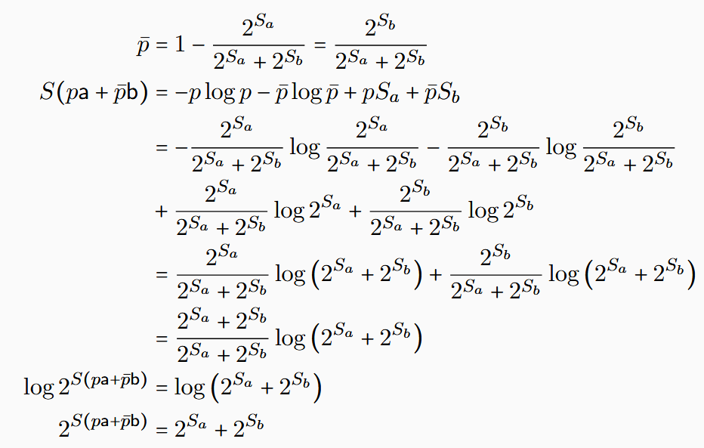
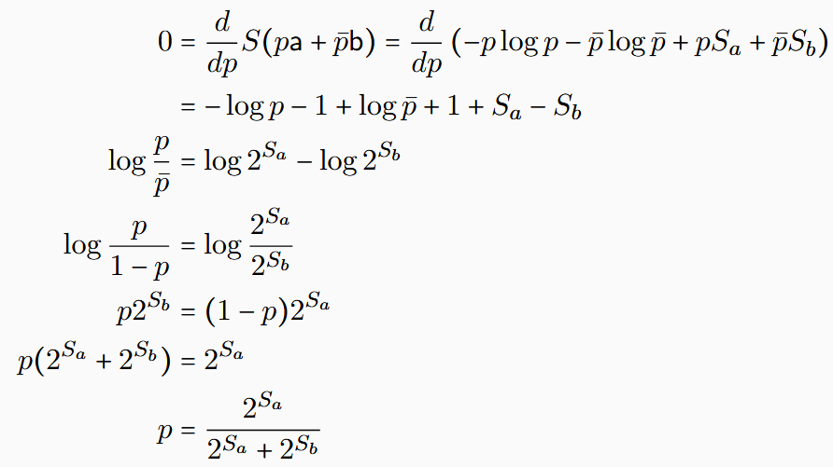
Maximum increase when ensembles are orthogonal. Find $p$ that maximizes entropy:
Then calculate final entropy:
Again, simple calculation that does not depend on type of space

Slide 49
Given a set of possible ensembles $A$, the count of configurations is the exponential of the maximum entropy reachable using mixtures. If $A$ is the set of classical distributions over a particular support $U$, the maximum entropy is given by the uniform distribution $⇒$ recovers the usual count of states! If $A$ is the set of density matrices that has zero eigenvalues outside of a subspace $H$, the state capacity recovers the dimensionality of the space $⇒$ count of distinguishable states!
capacity also name of a non-additive measure
fuzzy measure
State capacity is a non-additive measure
additive over orthogonal sets

Slide 50
Mixture
Probability
$$e_{1}$$
$$o_{1}$$
$$λ_{1}$$
$$p_{1}$$
$$e_{2}$$
Ensemble
$$o_{2}$$
Preparations
$$λ_{2}$$
$$p_{2}$$
Outcomes
$$⋮$$
$$⋮$$
$$λ_{n}$$
$$p_{n}$$
$$e_{n}$$
$$o_{n}$$
In classical mechanics, mixtures of preparations and probability of outcomes always coincide
In quantum mechanics, they do not
$⇒$ quantum ensemble spaces not simplexes (i.e. classical probability fails)
Can we have common measure theoretic tools on the preparation side?

Slide 51
How much of $e$ is a mixture of other ensembles?
$e=p\left(\sum_{i}{λ_{i}a_{i}}\right)+\overline{p}b$
biggest $p$
fuzzy measure
Fraction capacity is a non-additive probability measure

Slide 52
Takeaways
The principle of scientific reproducibility requires the notion of ensembles
We can develop a theory of states and processes using ensembles
Few physically justifiable starting points lead to a rich structure
Many definitions and proofs can be generalized in this setting
These notions provide a core foundation that can link to various standard mathematical theories
Topological vector spaces are the foundation of modern functional analysis
Information geometry can be shown to link to symplectic geometry of classical mechanics and the inner product of quantum mechanics
Non-additive measures provide a generalization of classical measure theoretic structures
Still a lot of work that needs to be done to complete the theory

Slide 53
Wrapping it up
Physical mathematics: derive the math required from physical requirements
In physics, mathematics is used to model physical systems, therefore we need mathematics that is designed specifically for that purpose
Principle of scientific objectivity: science deals with evidence-based assertions
Requires notion of verifiable statements
Leads to topological spaces (open sets corresponds to verifiable statements) and $σ$-algebras (Borel sets correspond to statements associated with tests)
Real numbers can be derived by modeling an idealized reference system
Principle of scientific reproducibility: scientific laws describe reproducible relationships
Requires notion of ensembles
Ensembles must be experimentally well-defined, allow statistical mixture and be associated with an entropy (that quantifies the variability of the instances of an ensemble)
Recovers notions of vector spaces, geometry and measure theory
Hopefully this shows that we can build the required math from the ground up

