Slide 1
Assumptions of Physics Summer School 2024 Thermodynamics and Statistical Mechanics
Gabriele Carcassi and Christine A. Aidala
Physics Department University of Michigan
https://assumptionsofphysics.org

Slide 2
Main goal of the project
Identify a handful of physical starting points from which the basic laws can be rigorously derived
For example:
Infinitesimal reducibility $⇒$ Classical state
Irreducibility $⇒$ Quantum state
https://assumptionsofphysics.org
?
time
time
This also requires rederiving all mathematical structures from physical requirements
For example:
Science is evidence based $⇒$ scientific theory must be characterized by experimentally verifiable statements $⇒$ topology and $σ$-algebras

Slide 3
Underlying perspective
Foundations of physics
Foundations of mathematics
Metaphysical reality
What really exists
Physical reality
What can be accessed experimentally
Philosophy of science
What is the boundary?
What are the requirements?
Physical theories
Idealized account of empirical reality
Empirical reality
What can be reliably studied experimentally
How exactly does the abstraction/idealization process work?

Slide 4
If physics is about creating models of empirical reality, the foundations of physics should be a theory of models of empirical reality
Requirements of experimental verification, assumptions of each theory, realm of validity of assumptions, …

Slide 5
Different approach to the foundations of physics
Find ultimate theory
approximation
…
Typical approaches
Construct interpretations
Weak interactions
QED -Electromagnetism
Measurement problem
Role of the observer
QCD – Strong Interactions
Electro-weak
Quantum mechanics
Contextuality
Local realism
General Relativity
Grand Unified Theory
Ontology of observables
What “really” happens
Theory of Everything
Our approach
A theory about physical models
General physical principles and requirements
General mathematical framework
Specific assumptions
Classical mechanics
Quantum mechanics
derivation
Thermodynamics
…
specialization

Slide 6
Find the right overall concepts
Reverse physics: Start with the equations, reverse engineer physical assumptions/principles
Reverse Physics
Physics
Smallest set of assumptions required to rederive the theory
Physical theory
Physical result/ effect/prediction
Reverse Mathematics
Mathematics
Smallest set of axioms required to prove the theorem
Theorem
Mathematical result/ corollary/calculation
Found Phys 52, 40 (2022)
Goal: find the right overall physical concepts, “elevate” the discussion from mathematical constructs to physical principles
Physical mathematics: Start from scratch and rederive all mathematical structures from physical requirements
Physics
Physical requirements
Semantics
Physical mathematics
Goal: get the details right, perfect one-to-one map between mathematical and physical objects

Slide 7
Reverse Physics: Thermo and Stat Mech
This session

Slide 8
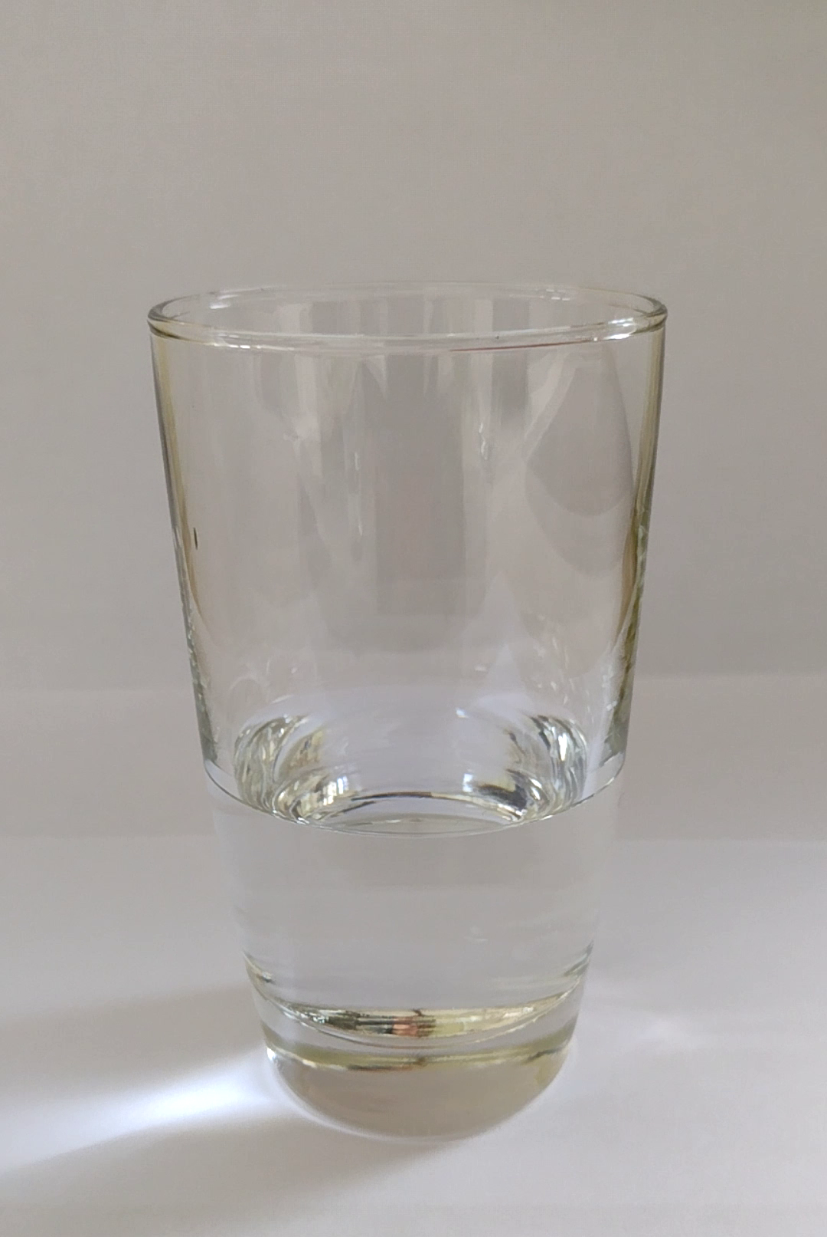
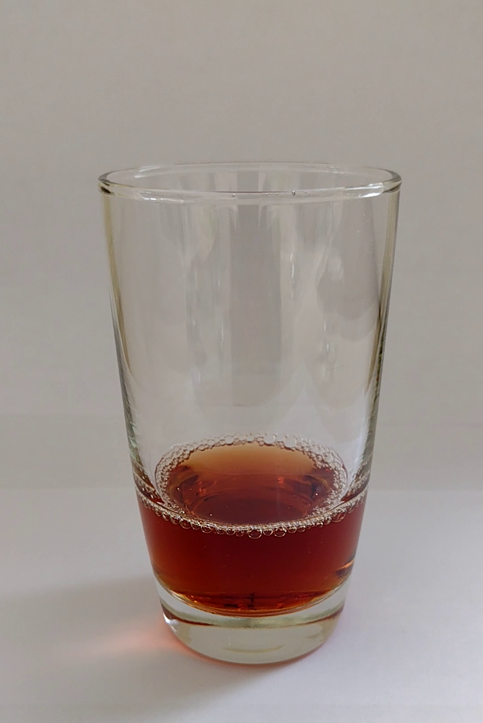
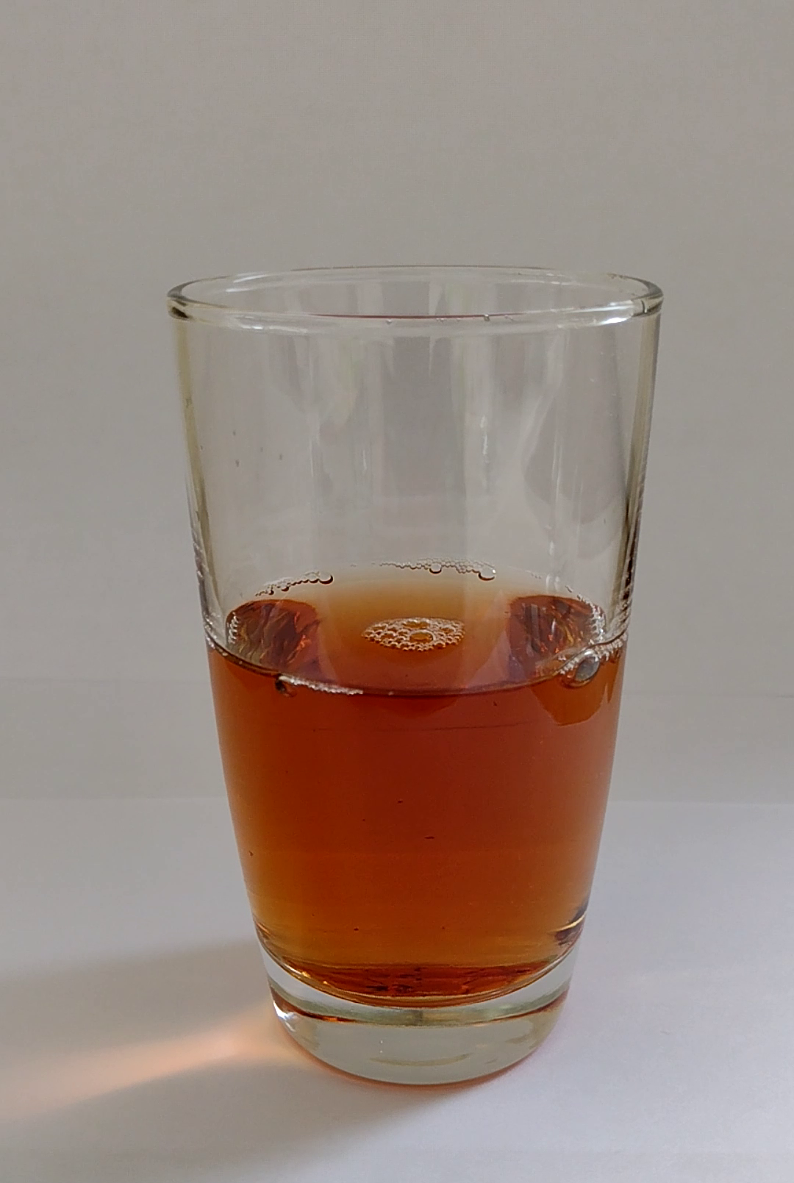
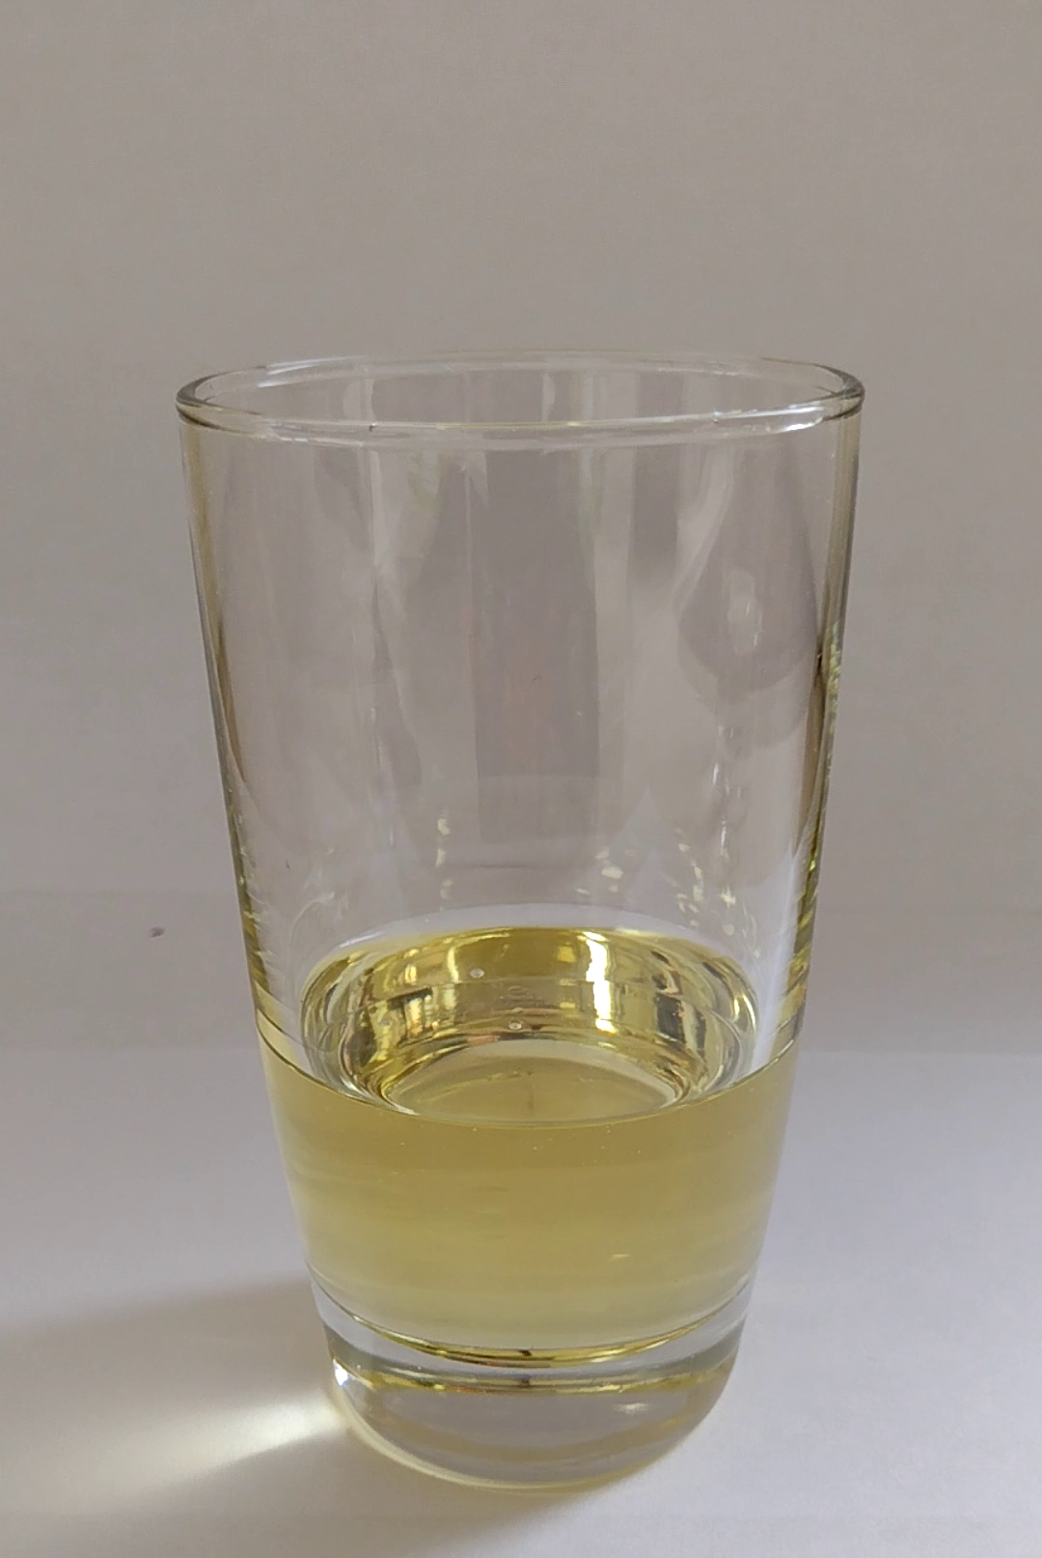
Puzzling things about entropy and equilibria
Entropy is disorder
If you mix water and vinegar, you increase entropy
If you mix water and oil, you increase entropy
???

Slide 9
Puzzling things about entropy and equilibria: dynamic vs thermodynamic
Dissipative forces shrink phase space volume
$$p$$
Smaller volume, smaller entropy
Dissipative forces reduce entropy
???
$$q$$
Equilibria are attractors, volume around them shrink
Smaller volume, smaller entropy
Entropy decreases as we go to equilibrium
???

Slide 10
Puzzling things about entropy and equilibria: relativity
Thermodynamic equilibrium: wait until nothing changes
Newton’s first law: a body remains in motion at a constant speed
No equilibrium
???
Gas in equilibrium in one reference: all macroscopic quantities stay the same
Moving reference: position is changing
Equilibrium is not an invariant property
???
$$t$$
$$\hat{t}$$
Gas increasing temperature very slowly, always in equilibrium
Moving reference sees a gradient of temperature
$$\hat{x}$$
Equilibrium is not an invariant property
$$x$$
???

Slide 11
Puzzling things about entropy and equilibria: information and equilibria
Entropy is information: $I(ρ)=−∫ρ log ρ$ where $ρ$ is the distribution over microstates
Gas at unknown temperature: $T_{1}$ or $T_{2}$ with 50% chance. One bit of entropy
Increase of Shannon entropy is less than 1: $I\left(\frac{1}{2}\left(ρ_{1}+ρ_{2}\right)\right)<\frac{1}{2}I\left(ρ_{1}\right)+\frac{1}{2}I(ρ_{2})+1$
???
Entropy is information: $I(ρ)=−∫ρ log ρ$ where $ρ$ is the distribution over microstates
I forget the temperature of the heat source: entropy is higher
I can extract less energy from the heat source
???

Slide 12
Clearly: in some sense entropy is about information, in some sense entropy is about disorder, thermodynamic equilibria is about things not changing, equilibrium identifies a privileged coordinate system, ….
But in exactly what sense?!?!?
Fundamental problem of thermodynamics

Slide 13
Information entropy

Slide 14
Shannon entropy as variability
Eur. J. Phys. 42, 045102 (2021)
more variability
Meaning depends on the type of distribution
Statistical distribution: variability of what is there
?
less variability
Probability distribution: variability of what could be there
?
Shannon entropy quantifies the variability of the elements within a distribution
Credence distribution: variability of what one believes to be there
$−∑p_{i}\log{p_{i}}$ only indicator of variability that satisfies simple requirements
This characterization works across disciplines
Continuous function of $p_{i}$ only
Increases when number of cases increases
Linear in $p_{i}$

Slide 15
Shannon entropy as variability
Is it alive?
Eur. J. Phys. 42, 045102 (2021)
Is it human made?
$$W$$
Does it live on land?
…
…
…
$$\frac{1}{N}\log{W}≈−∑p_{i}\log{p_{i}}$$
Efficient game of twenty questions
…
More variability, more permutations
…
Variability is also quantified by the logarithm of the number of possible permutations per element
More variability, more questions
Variability is quantified by the expected minimum number of yes/no questions required to identify an element
More variability for a distribution at equilibrium, more fluctuations, more physical entropy

Slide 16
Entropy as logarithm of the count of evolutions

Slide 17
Entropy as logarithm of evolutions
$μ\left(s_{t}\right)$: how many evolutions go through $s_{t}$?
Process entropy: $S=\log{μ}$
$$P\left(s_{t+Δt} | s_{t}\right)=\frac{μ\left(s_{t}∩s_{t+Δt}\right)}{μ\left(s_{t}\right)}$$
Determinism: evolutions cannot split $μ\left(s\left(t+Δt\right)\right)≥μ\left(s\left(t\right)\right)$
$$μ=2$$
$$μ=1$$
$$μ=2$$
Reversibility: evolutions cannot merge $μ\left(s\left(t+Δt\right)\right)≤μ\left(s\left(t\right)\right)$
$$t−Δt$$
$$t$$
$$t+Δt$$
For a deterministic process
$$μ\left(s\left(t+Δt\right)\right)≥μ\left(s\left(t\right)\right)$$
(equal if reversible)
(maximum at equilibrium)
For a deterministic process
$S\left(s\left(t+Δt\right)\right)≥S\left(s\left(t\right)\right)$
(equal if reversible)
(maximum at equilibrium)
$$t−Δt$$
$$t$$
$$t+Δt$$
System independence: evolutions of the composite are the product of individual systems: $μ_{XY}=μ_{X}μ_{Y}$
Entropy additive for independent systems
$$S_{XY}=S_{X}+S_{Y}$$
$$\left\{x\left(t\right),y\left(t\right)\right\}$$
$$x(t)$$
$$y(t)$$

Slide 18
Entropy as logarithm of evolutions
$μ\left(s_{t}\right)$: how many evolutions go through $s_{t}$?
Process entropy: $S=\log{μ}$
prepare $X$
interaction
measure $X$
Note: defining an evolution count is necessary in physics
prepare $Y$
measure $Y$
We compose processes by connecting inputs and outputs: all evolutions must connect!
Recovers other notions of entropy!
If det/rev, one state per evolution, count of evolutions is count of states
$⇒$ recover fundamental postulate of statistical mechanics!
If microstate fluctuates according to a distribution $ρ$, count of evolutions is count of permutations$⇒$ recover Shannon entropy!

Slide 19
State space of a system

Slide 20
State space of a system at different times
$$t−Δt$$
$$t$$
$$t+Δt$$

Slide 21
Evolution: complete description of the system at all times
$$t−Δt$$
$$t$$
$$t+Δt$$

Slide 22
A process defines the set of all possible evolutions
$$t−Δt$$
$$t$$
$$t+Δt$$

Slide 23
Each description at each time corresponds to a set of evolutions
We can count the number of evolutions for a particular state $s$ at a particular time with a measure* $μ(s)$ since $s$ identifies a set of evolutions.
$$μ=2$$
$$μ=1$$
$$μ=2$$
$$t−Δt$$
$$t$$
$$t+Δt$$
* The full mathematical characterization may be a bit more complicated (e.g. preorder that leads to a family of measures)…

Slide 24
The probability $P\left(s_{1} | s_{0}\right)$ of having $s_{1}$ given $s_{0}$ corresponds to the fraction of evolutions that go from state $s_{0}$ to state $s_{1}$
That is, $P\left(s_{1} | s_{0}\right)=\frac{μ\left(s_{0}∩s_{1}\right)}{μ\left(s_{0}\right)}$
$$50\%$$
$$t−Δt$$
$$t$$
$$t+Δt$$

Slide 25
A process is deterministic if knowing the state at a time allows us to predict the state at a future time
For these processes, we can properly write a law of evolution $s\left(t+Δt\right)=f\left(s\left(t\right)\right)$
$$t−Δt$$
$$t$$
$$t+Δt$$

Slide 26
In a deterministic process, the evolutions can never split, only merge
That is, $μ\left(s\left(t+Δt\right)\right)≥μ\left(s\left(t\right)\right)$
$$μ=1$$
$$μ=2$$
$$μ=1$$
$$μ=1$$
$$μ=3$$
$$t−Δt$$
$$t$$
$$t+Δt$$

Slide 27
A process is reversible if knowing the state at a time allows us to reconstruct the state at a past time
$$t−Δt$$
$$t$$
$$t+Δt$$

Slide 28
In a reversible process, the evolutions can never merge, only split
That is, $μ\left(s\left(t+Δt\right)\right)≤μ\left(s\left(t\right)\right)$
$$μ=1$$
$$μ=3$$
$$μ=2$$
$$μ=1$$
$$μ=1$$
$$t−Δt$$
$$t$$
$$t+Δt$$

Slide 29
In a det/rev process, evolutions can never merge nor split
That is, $μ\left(s\left(t+Δt\right)\right)=μ\left(s\left(t\right)\right)$
$$t−Δt$$
$$t$$
$$t+Δt$$

Slide 30
For a deterministic process
$$μ\left(s\left(t+Δt\right)\right)≥μ\left(s\left(t\right)\right)$$
(equal if reversible)

Slide 31
Consider a process where a system reaches a final equilibrium that can be predicted from the initial state
At equilibrium, evolutions cannot merge anymore
$$t−Δt$$
$$t$$
$$t+Δt$$

Slide 32
For a deterministic process
$$μ\left(s\left(t+Δt\right)\right)≥μ\left(s\left(t\right)\right)$$
(equal if reversible)
(maximum at equilibrium)

Slide 33
Suppose we have a composite of two systems
$$𝒮_{1}$$
$$𝒮=𝒮_{1}×𝒮_{2}$$
$$\left\{x\left(t\right),y\left(t\right)\right\}$$
$$𝒮_{2}$$
$$x(t)$$
$$y(t)$$
State space is the product
Evolutions, in general, are not the product: there may be correlations

Slide 34
$$\left\{x\left(t\right),y\left(t\right)\right\}$$
If the systems are independent, the evolution of one does not constrain the evolution of the other: all pairs are possible
For each pair of states there is a state for the composite system: $\#(𝒮)=\#(𝒮_{1})\#(𝒮_{2})$
$$x(t)$$
For each pair of evolutions there is an evolution of the composite: $μ\left(s_{1}∩s_{2}\right)=μ_{1}\left(s_{1}\right)μ_{2}(s_{2})$
$$y(t)$$
Note: $log μ=\log{μ_{1}μ_{2}}=\log{μ_{1}}+\log{μ_{2}}$
$log μ$ is additive for independent systems

Slide 35
Define the process entropy as $S=\log{μ}$
The log of the count of evolutions per state
It is additive for independent systems
$$S=S_{1}+S_{2}$$
For a deterministic process
$S\left(s\left(t+Δt\right)\right)≥S\left(s\left(t\right)\right)$ (equal if reversible)
(maximum at equilibrium)

Slide 36
Recover fundamental postulate of statistical mechanics (entropy is the logarithm of the count of microstates)
Suppose process deterministic and reversible at microscale
$⇒$ States and evolutions are one-to-one
$⇒$ Count of microstates equals count of evolutions
$⇒$ Entropy is the logarithm of the count of microstates

Slide 37
Suppose we have a dissipative system (e.g. damped harmonic oscillator)
$⇒$ Evolutions concentrate on fewer states
$⇒$ While count of states decreases, the density of evolutions (evolutions per state) increases
Focusing on the evolutions seems to solve the paradox of entropy for dynamical equilibrium

Slide 38
Recover information entropy
$$X$$
Suppose macrostate 𝑋 is a dynamical equilibrium of microstates
$⇒$ Microstate fluctuations can be characterized by a stable probability distribution 𝜌(𝑥) in each small $Δt$
$⇒$ An evolution 𝜆(𝑡) for the microstate is a dense sequence of infinitely many microstates whose recurrence matches 𝝆
$⇒$ Macrostate measurements cannot be sensitive to permutations of microstates: possible evolutions equals all possible permutations
$⇒$ Shannon entropy counts all possible permutations of an infinite sequence (dense in $Δt$) which equals all possible evolutions
$$x$$

Slide 39
Macrostate/equilibrium is a “tube” of evolutions at the lower level
$$X$$
Equilibrium means that no evolution enters or exits the “tube” (i.e. external agents have equilibrated)
The variables describing the macrostate can still change
(i.e. the “tube” moves around in state space)
We can now study the “tube” as if it were single line
(i.e. internal dynamics and environment are decoupled)
$$x$$
Equilibrium = evolution decoupled from environment and internal dynamics

Slide 40
$$X$$
Equilibrium = evolution decoupled from environment and internal dynamics
Automatically relativistic: about evolutions (i.e. timelines)
$$x$$
Quasi-static evolution NOT relativistic
same count
$$X$$
$$t$$
$$\hat{t}$$
$$\hat{x}$$
$$x$$
$$x$$
different count

Slide 41
Process entropy
We have not mentioned uncertainty, disorder, statistical distributions, information, lack of information, …
Therefore those concepts are not fundamental in this context
We have not discussed what type of state or system we have (classical, quantum, biological, economic, …)
Therefore everything we said is valid independently of the type of system, which would explain the success of thermodynamic ideas outside the realm of physics
The process entropy increase is explained by the definitions and the settings (processes with equilibria that depend on the initial state)
The explanation is straightforward (i.e. does not require a complicated discussion)
The explanation is not mechanical (i.e. given by a particular mechanism)

Slide 42
How does process entropy become the entropy state variable?
Why would we need to define a count of evolutions?

Slide 43
$$A$$
$$x$$
$$A$$
Why would we need to define a count of evolutions?
$$B$$
$$B$$
Note: if we want to “switch” processes (e.g. mix and match preparations, evolutions and measurements) the evolution count at the junction must be uniquely defined
$$C$$
$$C$$
$$…$$
$$…$$
$⇒$ Evolution count is a necessary feature of a theory for states and processes

Slide 44
Equilibria can be assigned a unique entropy
Suppose the same state $x$ is an equilibrium for two processes $A$ and $B$
$$A$$
$$x$$
$$B$$
$$x$$
Two ways of combining the processes: first A then B and vice versa
$$B$$
$$x$$
$$A$$
$$x$$
All the evolutions of $A$that end in $x$ will also end in $x$ under $AB$ and $B$
All the evolutions of $B$that end in $x$ will also end in $x$ under $BA$ and $A$
Count of evolutions of $x$ must be process independent
Equilibria allow us to assign unique (maximal) entropy to states

Slide 45
For composite systems, recall
that in general the process entropy is not unique
$$\left\{x\left(t\right),y\left(t\right)\right\}$$
Due to correlations between subsystems
If the systems are independent, however, the process entropy is well defined
$$x(t)$$
$$y(t)$$
It sums and corresponds to the maximum
System independence allows us to assign unique (maximal) entropy to composite states

Slide 46
State entropy
We can assign a unique maximal process entropy to “states of independent equilibria”, which we call state entropy
Both equilibria and independence maximize process entropy
We leave these notions somewhat “vague” for now (we are still doing better than standard thermodynamics anyway)
Given a set $X$ of states of equilibria, we can define the function $S:X→ℝ$ that returns the state entropy for each equilibrium
We call this the equation of state in entropic form
First goal reached: under very general definitions, we have found a simple notion of entropy (logarithm of the count of evolutions) that has a fundamental (almost trivial) link to irreversibility

Slide 47
Takeaways
We need a well defined count of evolutions to “stitch” together preparations, evolutions and measurement processes
The logarithm of the count of evolutions recovers the properties of the entropy and can recover both definitions of entropy under suitable additional assumptions
Equilibrium = evolution decoupled from environment and internal dynamics
All properties descend directly from simple requirements and considerations
TODOs:
Actually write down the full theory

Slide 48
Recovering thermodynamics

Slide 49
“Reversing” thermodynamics
Assume states are equilibria of faster scale processes
$β=\frac{1}{k_{B}T}=\frac{∂S}{∂U}$ and $−βX_{i}=\frac{∂S}{∂x^{i}}$
$$dS=\frac{∂S}{∂U}dU+\frac{∂S}{∂x^{i}}dx^{i}=βdU−βX_{i}dx^{i} \\ k_{B}TdS=dU−X_{i}dx^{i} \\ dU=T\left(k_{B}dS\right)+X_{i}dx^{i}$$
Define intensive quantities
Assume states identified by extensive properties
Assume one of these quantities is energy $U$
$$S(U,x^{i})$$
Existence of equation of state
Recover usual relationships
Study interplay of changes of energy and entropy
$$ΔU=0=ΔU_{A}+ΔU_{R}+ΔU_{M} \\ =ΔU_{A}−Q+W$$
First law recovered from existence and conservation of Hamiltonian
$$R$$
Reservoir: energy only state variable, entropy linear function of energy
Recover first law
All energy stored in entropy
$$Q$$
$$0≤ΔS=ΔS_{A}+ΔS_{R}+ΔS_{M} \\ =ΔS_{A}+β_{R}ΔU_{R}+0=ΔS_{A}+\frac{−Q}{k_{B}T_{R}}$$
Mechanical system: same entropy for all states
$$A$$
$$M$$
$$W$$
No energy stored in entropy
Recover second law
$$β=\frac{1}{k_{B}T}=0$$
Second law recovered from definition of entropy as count of evolutions

Slide 50
Suppose we take a composite system and at some point we split it such that each part will follow its own process
$$x$$
$$B$$
$$x_{1}$$
$$(x_{0},y_{0})$$
$$A$$
$$(x,y)$$
$$y$$
$$C$$
$$y_{1}$$
Not only do we need a well defined evolution count for the composite, but also for each part
This requires us to extend the notion of equilibria to the parts

Slide 51
Thermodynamic process
Thermodynamic processes extend the notion of deterministic process with equilibria to composite systems
We define a thermodynamic process as a deterministic process with equilibria such that:
in the final equilibrium all parts are independent and at equilibrium
the final equilibrium depends non-trivially on the initial state of any part
at equilibrium
$$X⋃Y$$
$$X⋃Y$$
$$A$$
$$X$$
$$Y$$
$$X$$
$$Y$$
non-trivial dependence
independent

Slide 52
Thermodynamic equilibrium
A thermodynamic equilibrium is the output of a thermodynamic process
Two systems are in thermodynamic equilibrium if they are parts of the same thermodynamic equilibrium
$$…$$
$$X⋃Y⋃Z$$
$$…$$
Mathematically, systems under composition form a Boolean algebra. An equilibrium is a downward set with a greatest element.
$$X⋃Y$$
$$Y⋃Z$$
$$…$$
$$X$$
$$Y$$
$$Z$$
$$…$$

Slide 53
Thermodynamic equilibrium is transitive
$$…$$
Suppose $A$ is in thermodynamic equilibrium with $B$ and $B$ is in thermodynamic equilibrium with $C$.
Then $A$ and $B$ are parts of the output of the same thermodynamic process. But $B$ and $C$ are also parts of the output of the same thermodynamic process.
Therefore $A$ and $C$ are parts of the output of the same thermodynamic process: they are in thermodynamic equilibrium.
$$X⋃Y⋃Z$$
$$…$$
$$X⋃Y$$
$$Y⋃Z$$
$$…$$
This recovers the zeroth law of thermodynamics
$$X$$
$$Y$$
$$Z$$
$$…$$

Slide 54
Thermodynamic systems
We say $A$ is a thermodynamic system if
the state space $𝒮_{A}$ is formed by states of equilibrium
all state variables (i.e. quantities that identify the state of the system) are extensive properties of the system (i.e. sum under system composition, like entropy)*
One of these quantities, called internal energy, is conserved under all thermodynamic processes*
We will indicate with $U$ the internal energy and with $x^{i}$ all other state variables
* It may be possible to derive the existence of extensive quantities… For now we leave this as an extra assumption
* This may be justified by isolation of system + env, which leads to existence and conservation of Hamiltonian

Slide 55
Existence of an equation of state
Because the states are equilibria, we have a function $S:𝒮_{A}→ℝ$ that returns the state entropy (maximized process entropy) for each state
Because $(U,x^{i})$are state variables, we can express $S(U,x^{i})$ as a function of the variables
A thermodynamic system has an equation of state $S(U,x^{i})$

Slide 56
Thermodynamic quantities
Define the following variables:
$β=\frac{1}{k_{B}T}=\frac{∂S}{∂U}$ and $−βX_{i}=\frac{∂S}{∂x^{i}}$
$$dS=\frac{∂S}{∂U}dU+\frac{∂S}{∂x^{i}}dx^{i}=βdU−βX_{i}dx^{i} \\ k_{B}TdS=dU−X_{i}dx^{i} \\ dU=T\left(k_{B}dS\right)+X_{i}dx^{i}$$
Compare to $dU=TdS_{Thermo}−pdV+μ_{i}dN^{i}+…$
$k_{B}dS$ corresponds to the thermodynamic entropy
The other variables correspond to thermodynamic pairs

Slide 57
Changes of energy and entropy
Now we want to study how changes in energy and changes in entropy relate to each other
To do that, it is useful to characterize two “orthogonal” directions:
changes of energy at equal entropy
changes of energy at maximum entropy change

Slide 58
Reservoir
We define a reservoir $R$ as a thermodynamic system where the energy $U_{R}$ is the only state variable and $\frac{∂S_{R}}{∂U_{R}}=β_{R}=\frac{1}{k_{B}T_{R}}=const$. We call heat $Q=−ΔU_{R}$ the energy lost by the reservoir during a transition.
Heat is energy exchanged under a purely entropic change
no other extensive quantity changes

Slide 59
Mechanical system
We define a mechanical system $M$ as a system such that the entropy is the same for all states. That is: $S_{M}\left(U_{M},x_{M}^{i}\right)=const$. We call work $W=ΔU_{M}$ the energy acquired by a purely mechanical system during a transition.
$$dS_{M}=0=β_{M}dU_{M}−β_{M}X_{Mi}dx_{M}^{i}$$
$$dU_{M}=X_{Mi}dx_{M}^{i}$$
Work is energy exchanged at constant entropy. Constant entropy (as we saw) corresponds to deterministic and reversible processes. The energy is effectively “stored” in the other variables and can be retrieved later.

Slide 60
First law
Consider a composite system made of a generic system $A$, a reservoir $R$ and a purely mechanical system $M$. Consider a transition where we go to a new equilibrium.
Since the energy is extensive (i.e. additive under system composition), let $U$ be the total energy. We also assumed the energy is conserved. We have:
$ΔU=0=ΔU_{A}+ΔU_{R}+ΔU_{M}=ΔU_{A}−Q+W$
$ΔU_{A}=Q−W$
$$R$$
$$Q$$
$$A$$
$$M$$
$$W$$
This recovers the first law of thermodynamics

Slide 61
Second law
Since entropy is extensive (i.e. additive under system composition), let $S$ be the total entropy. Since the process is deterministic, the entropy cannot decrease. We have:
$0≤ΔS=ΔS_{A}+ΔS_{R}+ΔS_{M}=ΔS_{A}+β_{R}ΔU_{R}+0=ΔS_{A}+\frac{−Q}{k_{B}T_{R}}$
$k_{B}ΔS_{A}≥\frac{Q}{T_{R}}$
$$R$$
$$Q$$
$$A$$
$$M$$
$$W$$
This recovers the second law of thermodynamics

Slide 62
Recall the definition of state entropy
Count of evolutions
$S=\log{μ(x)}$
$$μ=3$$

Slide 63
Recall the definition of state entropy
Count of evolutions
$S=\log{μ(x)}$
$μ=$ 1
The least we can have is a single evolution
The case where the equilibrium can be reached from only one starting condition
$S≥\log{1}=0$
State entropy is non-negative, bounded from below at zero
Evolution of a pure ground state fits into the single evolution case
This recovers part of the third law of thermodynamics

Slide 64
Existence of equilibria forces $S(U)$ to be concave
$$b$$
$$a$$
$$S$$
Since $S(U)$ is non-negative, we have three cases:
a) No maximum energy, entropy monotonically increasing b) No minimum energy, entropy monotonically decreasing
c) Minimum and maximum energy, entropy minimum at either edge
$$c$$
$$U$$
If we combined two systems, one strictly monotonically increasing with another strictly monotonically decreasing, maximization of entropy would happen at infinity: we have no equilibrium
The first 2 cases can’t both exist:
By convention, we say energy is bounded from below. Minimum entropy is reached at the lowest energy state.
This recovers the remaining part of the third law of thermodynamics

Slide 65
Other argument
Entropy is additive for independent systems
$$S_{AB}=S_{A}+S_{B}$$
Null state $∅$: the system is missing/has zero particles
Acts as a “zero” under system composition: $A∪∅=A$.
$$S_{∅}=S_{∅∅}=S_{∅}+S_{∅}=0$$
Single possible evolution for null system
No state can describe a system more accurately than stating the system is not there in the first place
Principle of maximal description
Equivalent to the third law

Slide 66
Takeaways
Thermodynamics recovered as describing equilibria of systems and parts
The notion of process entropy maps to thermodynamic entropy in a very natural way
The notion of thermodynamic equilibrium as an equilibrium at all scales is already something people discuss (citation needed)
Again: we have not mentioned uncertainty, disorder, statistical distributions, information, lack of information, …
Again: we have not discussed what type of state or system we have (classical, quantum, biological, economic, …)
TODO:
Actually write down the whole theory

Slide 67
Prelude to quantum

Slide 68
$$S[ρ]$$
Classical uncertainty principle
Region with classical distributions
Classical mechanics has no lower bound on entropy $⇒$ violates third law! What happens if we impose one?
Let $W_{0}$ be the volume of phase space over which a uniform distribution has zero entropy.
Minimum uncertainty
$$σ_{q}σ_{p}≥\frac{W_{0}}{2πe}$$
Int J Quant Inf 18, 01, 1941025 (2020)
$$σ_{q}σ_{p}$$
Equality for independent Gaussians
$$0$$
Excluded by 3rd law
Lower bound on entropy $⇒$ lower bound on uncertainty
Don’t need the full quantum theory to derive the uncertainty principle: only the lower bound on entropy

Slide 69
3rd law of thermodynamics and uncertainty principle
Classical mechanics
Third law of thermodynamics
Lower bound on entropy
+
Uncertainty principle
Quantum mechanics
Principle of maximal description
No state can describe a system more accurately than stating the system is not there in the first place
The uncertainty principle is a consequence of the principle of maximal description
Can we understand the rest of quantum mechanics in the same way?

Slide 70
Wrapping it up
Basic concepts, like entropy and equilibria, are linked to fundamental requirements for defining physical systems
Thermodynamics is more fundamental than people think
Thermodynamics extends these concepts to equilibria among subsystem
Ideas are general and could explain why techniques from thermodynamics have found place in ecology, economics and other fields
We think we have good foundational ideas, but we still need to put them together

